Slide 1

Report of Task 3
by
Shubham Kashyap

Slide 2
Title: Cross Site Scripting
Domain: vulnweb.com
Subdomain: testasp.vulnweb.com/Search.asp
Steps:
Step 1: Visit http://testasp.vulnweb.com/
Step 2: On the top menu you will find a search option.
Step 3: Click on it and you will be prompted with the Search box.
Step 4: You can intercept the request in Burp Suite
Step 5: Now you can find different payloads for XSS.
Step 6: Send the request to the intruder and paste all the payloads.
Step 7: Try to find a successful payload for XSS.
Step 8: Prepare a report for it.

Slide 3
Impact:
Cross Site Scripting can lead to session hijacking to credential theft and other security vulnerabilities.
Prevention:
Validate to catch potentially malicious user-provided input.
Encode output to prevent potentially malicious user-provided data from triggering automatic load-and-execute behaviour by a browser.

Slide 4
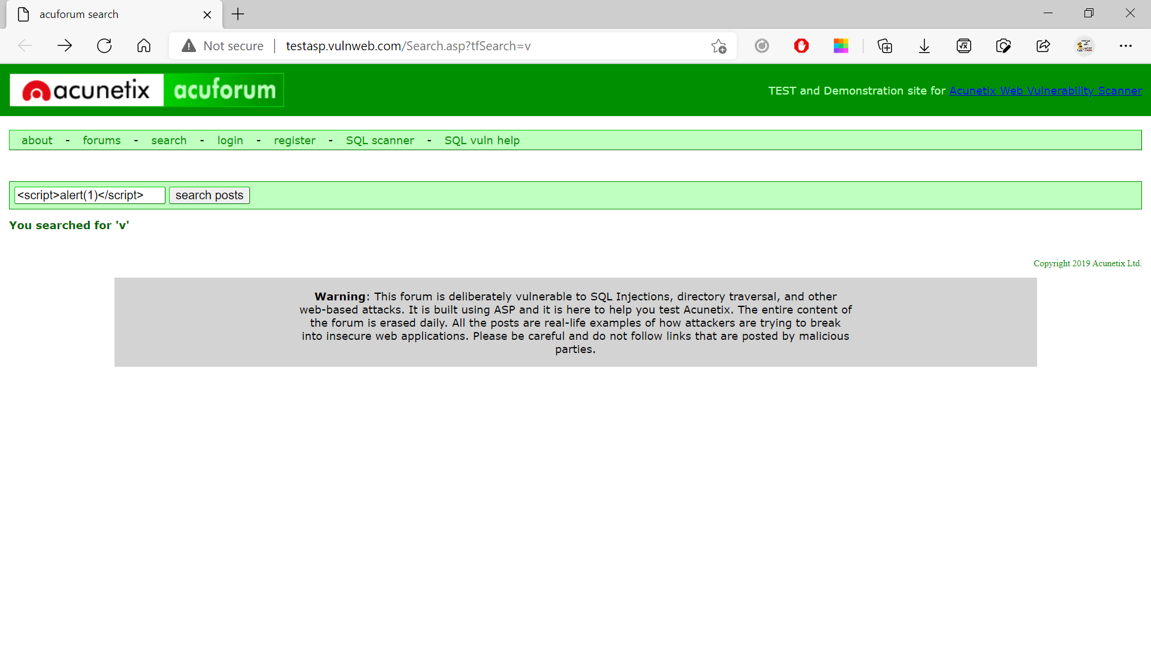

Slide 5
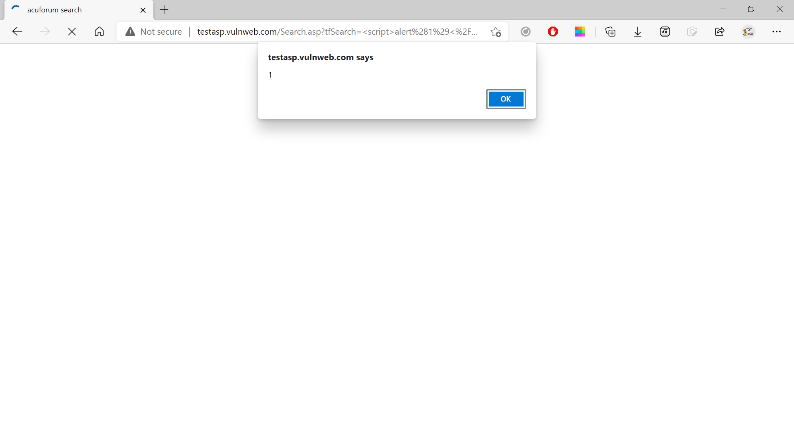

Slide 6
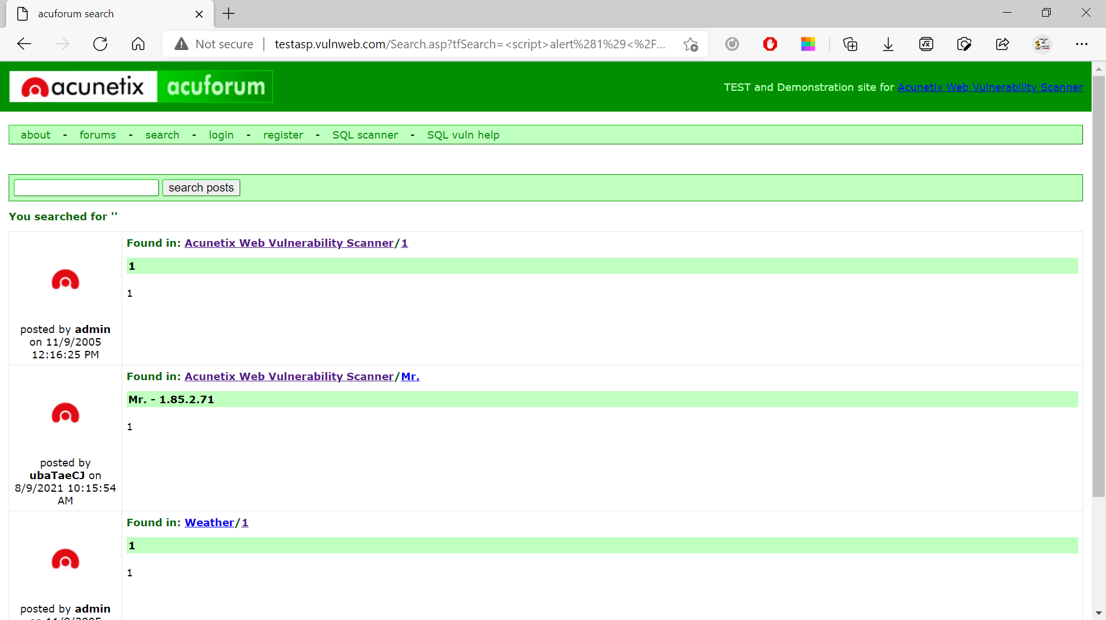

Slide 7
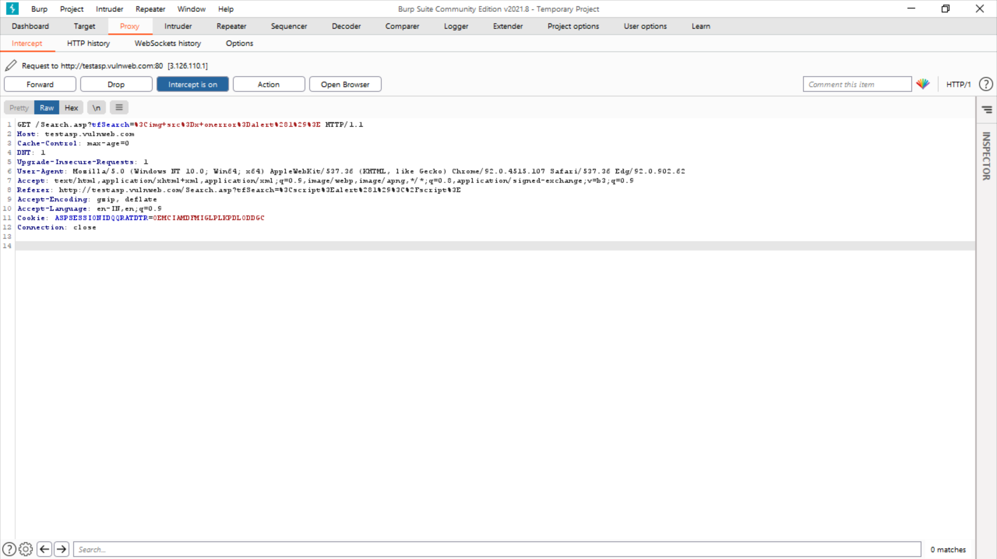

Slide 8

Thank You

